Slide 1
Section Manager Performance Measurement
Nov 2021

Slide 2
Scoreboard & Evaluation
Performance Distribution
Category | Metrics | Assessment criteria | Data sources | Property
Business Indicators | RIF | # RIF | EHS Report | Performance
 | Missed defects |  |  | Performance
 | Efficiency
 | OT
Lean Assessment | CI | Valid CI/Month |  | Culture & attributes
 | Gamba | Gemba finding# |  | Culture & attributes
 | PID /OPM
Leadership attributes | EI | Employee insight survey score |  | Culture & attributes
 |  | %? Meet target in X matrix |  | Culture & attributes
5 | 8 | 9
3 | 6 | 7
1 | 2 | 4
Culture & attributes
□Super
□Exceed
□Expected
□Not meet
Priorities for next action
Performance
Align people and strategy
Define the weight of each scores
Setting of bonus items and subtract items
Design an algorithm for evaluating scores
Agile performance management
Effective performance plans
People capabilities analysis
Personalized development plans
Timely feedback
Ready-to-share employee reports

Slide 3
Performance Appraisal
REFLECT
What is required of the person in their job? What does high performance look like?
Establish the process of evaluating and documenting section manager’s performance with a view to enhancing
REWARD
Recognize a job well done with financial or non-financial rewards
FEEDBACK
Provide section manager with timely & meaningful feedback (two-stage)
SET GOALS
Goals should be aligned to business needs
COD Culture
pay for performance
CAT PMP Connection
strengthen discipline
eliminate factionalism
Digitize indicators
??Supporting function
REVIEW
Formally evaluate progress and document performance results
DEVELOP
Identify and plan learning needs
reflect on what is required of the employee to do their job well (including behaviors and results)
set goals that will benefit the individual and the business
share two-stage feedback on great work as well as areas for improvement
identify opportunities to develop performance through ongoing education, training and learning
formally review performance after a specific period
reward a job well done
Notes:
work quality
output
Efficiency
What Are The 6 Steps To A Successful Performance Appraisal?

Slide 4
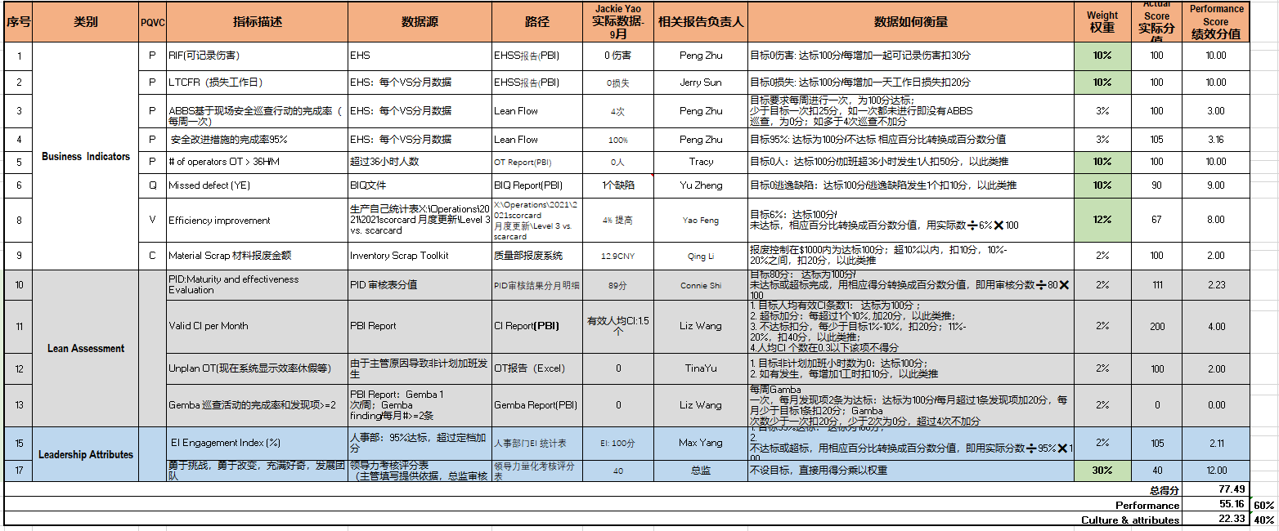
Marking Standard
Notes:
work quality
output
Efficiency
What Are The 6 Steps To A Successful Performance Appraisal?

Slide 5
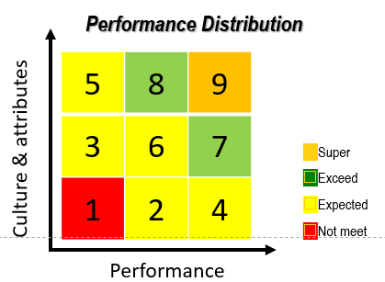
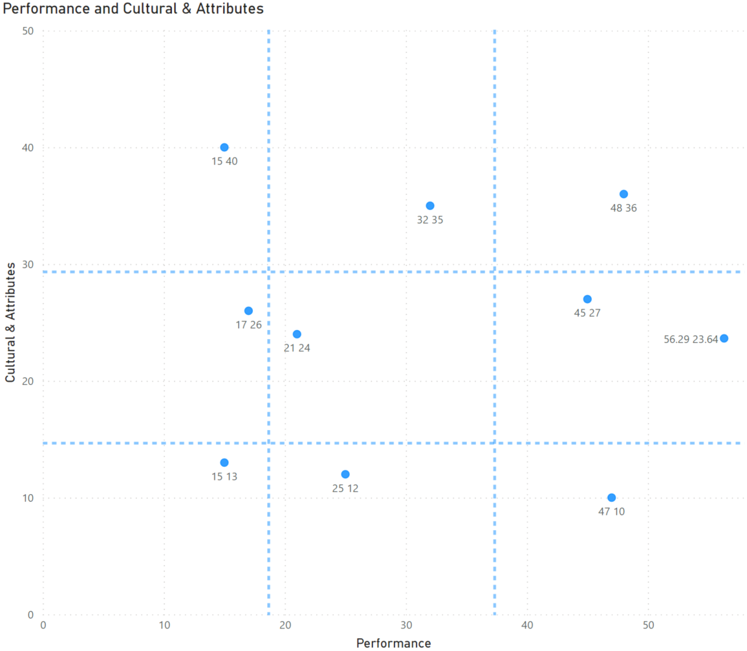
An Example
Jackie Yao
We place all the performance and Culture & Attributes scores in a coordinator.
Through this way, we could see the distribution vividly and hence we could evaluate them.
Notes:
work quality
output
Efficiency
What Are The 6 Steps To A Successful Performance Appraisal?

Slide 6
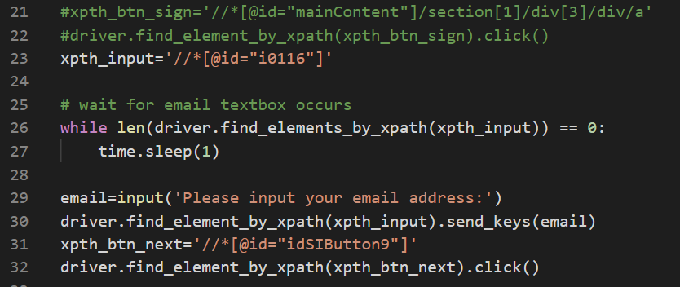
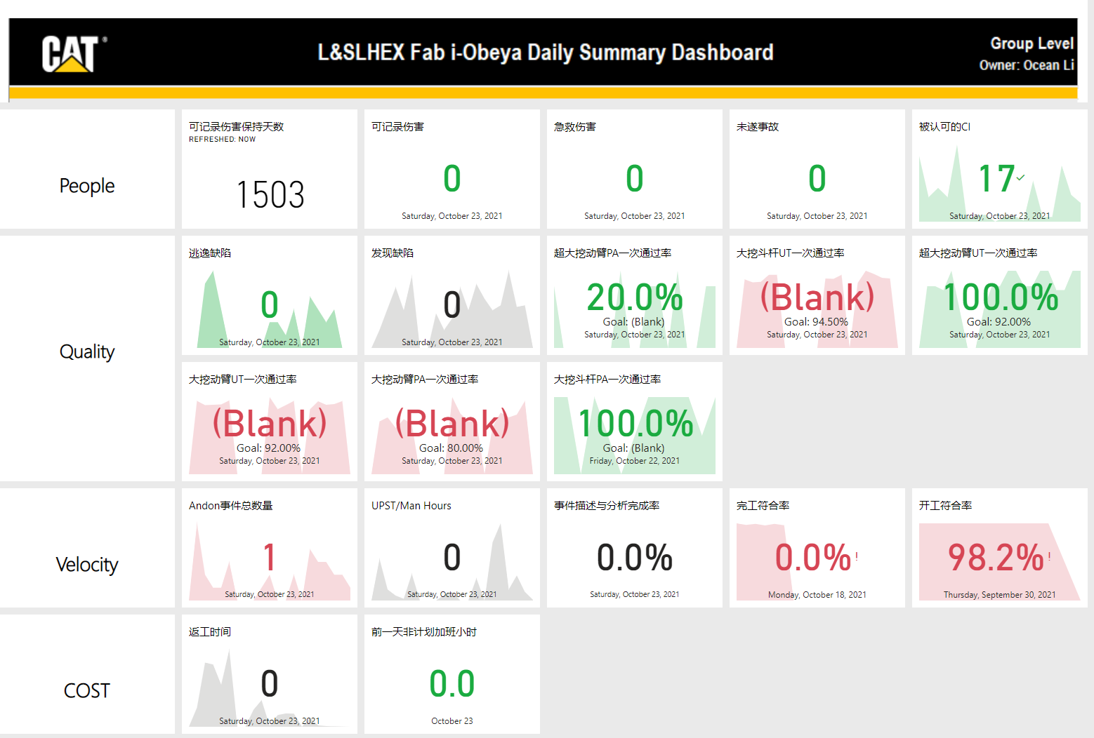
Key Data Extract Plans
Plan 1:
Make a power BI report which concludes all the models for calculating the key KPIs.
Not possible, too complicated to be refreshed and too much repetitive works to do.
Plan 2:
RPA solutions： Develop a Python program that could get the data from i-Obeya dashboards.
Run into trouble, need to input the keywords every time to lo into the system.
Plan 3:
RPA solutions：Use Power Automate to solve the problem.
Prepare to try, have no results yet.
Power Automate
Notes:
work quality
output
Efficiency
What Are The 6 Steps To A Successful Performance Appraisal?

Slide 7










Process Overview
Problem：
The calculated results stored in Power BI reports are hard to be extracted.
Calculating Stage
Storage Stage
Data Warehouse/Data Lake
ETL
ELT
Repository
Ingestion Stage
Notes:
work quality
output
Efficiency
What Are The 6 Steps To A Successful Performance Appraisal?

Slide 8
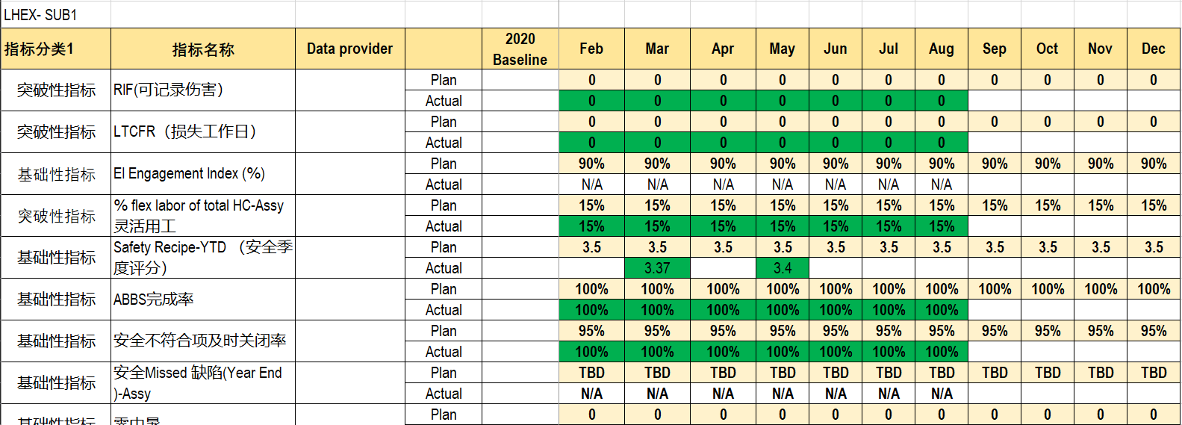
Develop a Python program that could get the data from Scorecard
Use the scorecard dashboard to extract the key data of each section manager
X:\Operations\L厂房区域公共文件\L 厂房战略分解-Y\2021\2021 scorecard 月度更新
Notes:
work quality
output
Efficiency
What Are The 6 Steps To A Successful Performance Appraisal?

